Slide 1
Sponsored by
Notes:
TDM- Travel Demand Management

Slide 2
COMMUTING IN THE CAPITAL REGION
TODAY’S REALITY
COMMUTER IMPACTS
Traffic congestion
Construction projects
Cost of fuel
The Great Resignation
Time wasted
Expensive commutes
Frustrated
Stressed
Burned out

Slide 3
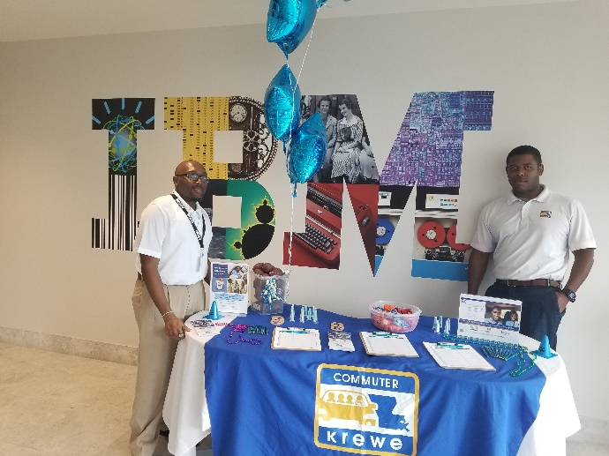
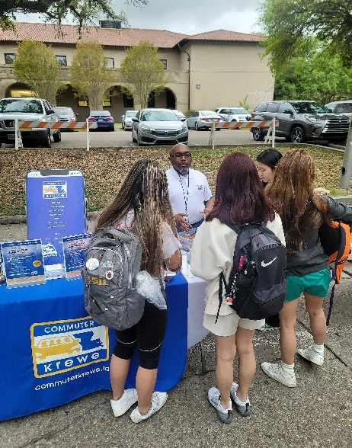
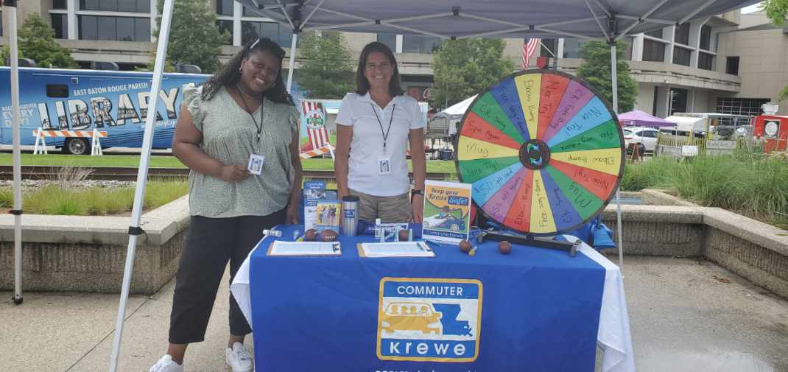
COMMUTER KREWE
Serve 5 parishes
East Baton Rouge
West Baton Rouge
Ascension
Livingston
Iberville
Reduce congestion and cars on our roadways
Promote shared rides & active transportation

Slide 4
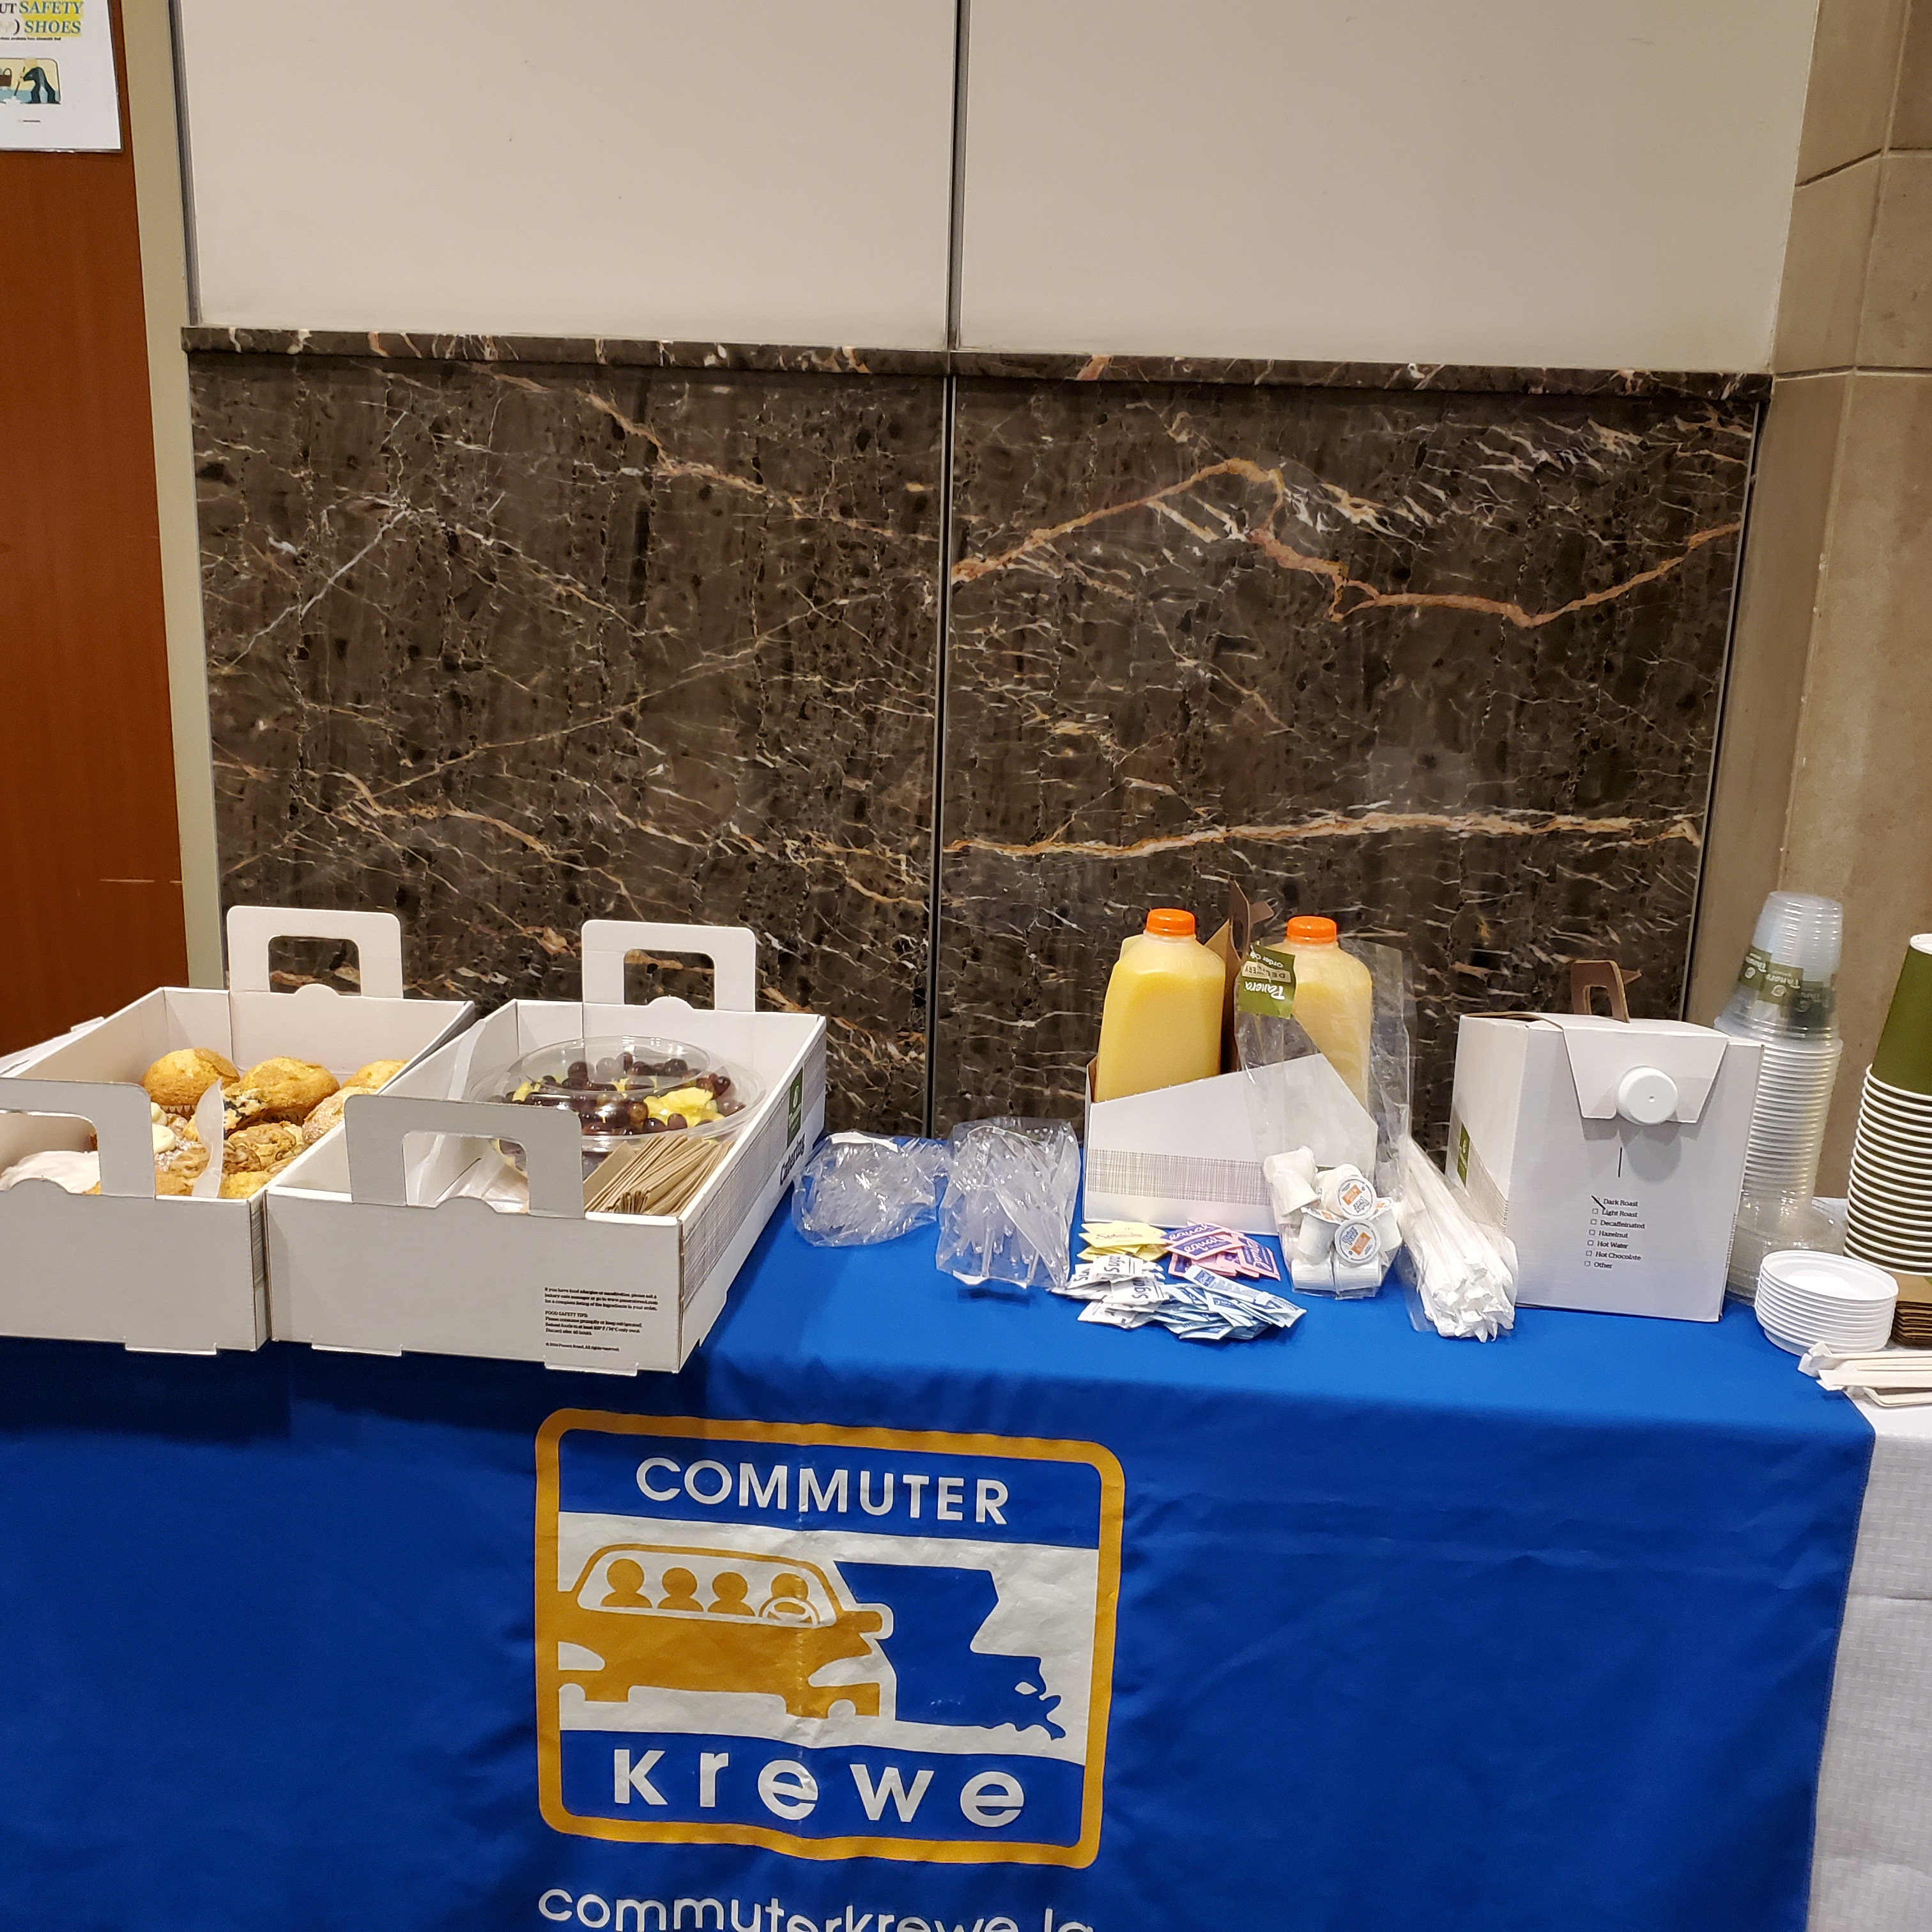
Programs & Services
Program consultation
Digital platform to form carpools
Employee events
Luncheons/Workshops
Prize drawings
Tax benefits
Emergency Ride Home
Notes:
Here is an overview of the programs functions.
Let me emphasize the Emergency Ride Home function.
In order to make people feel more comfortable with carpooling, we provide a ride home, in case of emergencies, to no cost to the commuter.
If someone in a carpool gets an urgent call from day care, for example, they simply call Uber or a taxi and go. The cost of the taxi or Uber gets is entirely reimbursed.

Slide 5
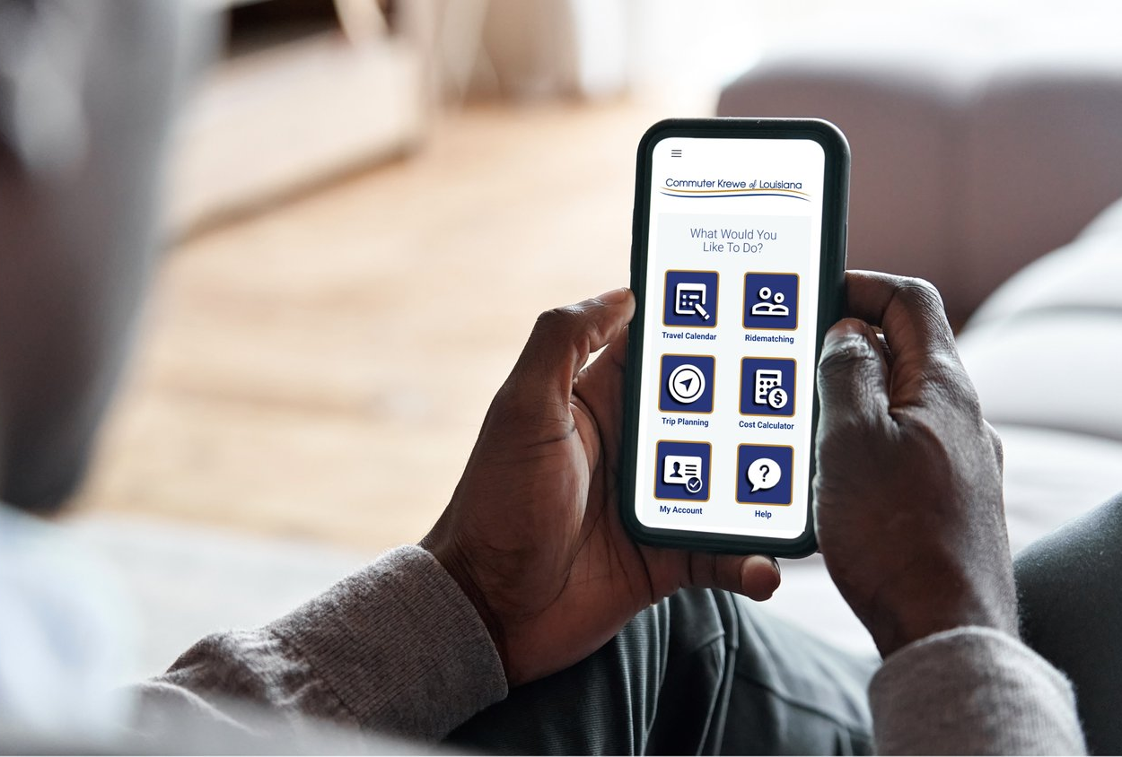
WHAT’S IN IT FOR EMPLOYEES?
App to connect with carpoolers
Record trips & win!
Prize drawings
Save money
Reduce stress
Stay happy!

Slide 6
YOU can join the krewe!
1. Designate a Commuter Krewe Captain
2. Distribute educational materials
3. Provide onsite access for commuter events
Notes:
Decide who’s your Commuter Krewe Captain or Employee Transportation Coordinator (ETC)
Advised to appoint 2 employees to be point of contact for your site
Encourage enrollment into ride matching system using most practical and effective methods at your worksite
Internal newsletters
Emails
Bulletin board posts
Gamification
Accommodate our engagement events where we will assist your staff to register.

Slide 7
PARTNER SPOTLIGHTS
Notes:
City-Parish:
Purchasing & Information Services
Universities and Technical Colleges
LSU, SU, BRCC, RPCC, Fortis, ITI, Moore
State Departments:
Division of Administration
Public and Private Establishments
AT&T, Belle of Baton Rouge, Capital Produce
Medical Facilities
AmeriHealth Caritas and OLOL FranU

Slide 8
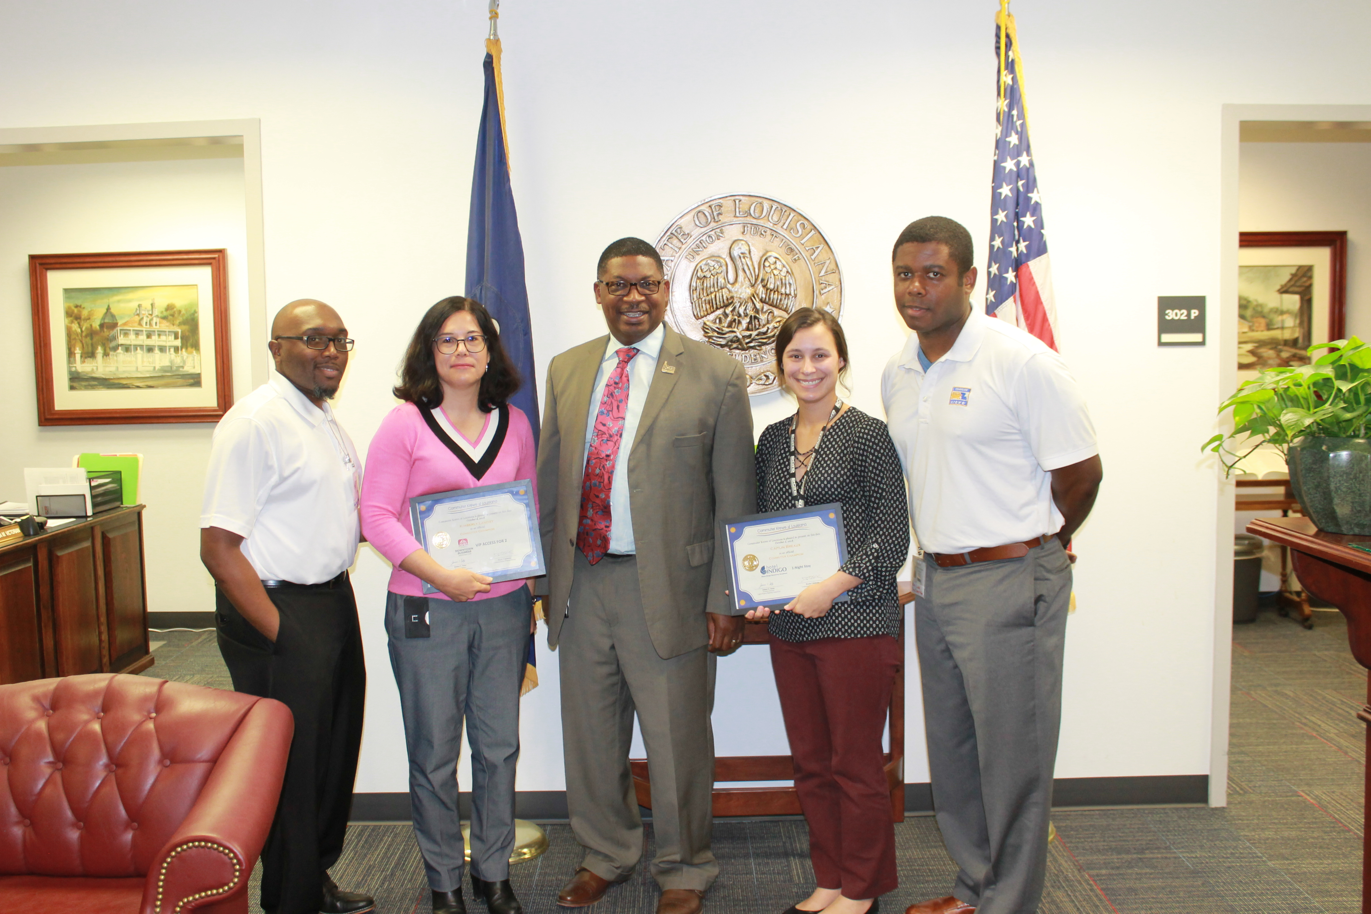
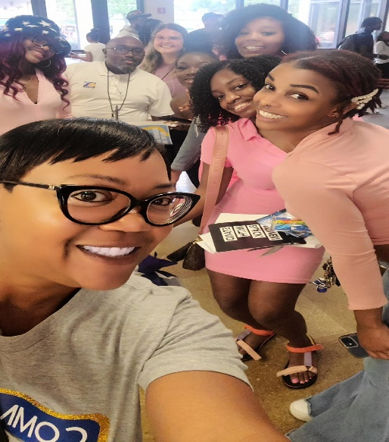
Stay Connected
Kenyatta M. Robertson
TDM Program Manager
225-256-7225 krobertson@crpcla.org
Carlinton ‘CJ” Jones
Outreach Coordinator
225-366-9515
cljones@commuterkrewe.la
225-344-RIDE
Info@CommuterKrewe.la

